Slide 1


4: Aggregating Pandas DataFrames

Slide 2
Aggregating Pandas DataFrames
The following topics will be covered in this lesson:
Performing database-style operations on DataFrames
Using DataFrame operations to enrich data
Aggregating data
Working with time series data
Notes:
In this lesson, we will continue our discussion of data wrangling from lesson 3, Data Wrangling with Pandas, by addressing the enrichment and aggregation of data. This includes essential skills, such as merging dataframes, creating new columns, performing window calculations, and aggregating by group membership. Calculating aggregations and summaries will help us draw conclusions about our data.
We will also take a look at the additional functionality pandas has for working with time series data, beyond the time series slicing we introduced in previous lessons, including how we can roll up the data with aggregation and select it based on the time of day. Much of the data we will encounter is time series data, so being able to effectively work with time series is paramount. Of course, performing these operations efficiently is important, so we will also review how to write efficient pandas code.
This lesson will get us comfortable with performing analyses using DataFrame objects. Consequently, these topics are more advanced compared to the prior content and may require a few rereads, so be sure to follow along with the notebooks, which contain additional examples.

Slide 3
Performing database-style operations on DataFrames
For this section, we will be working in the 1-querying_and_merging.ipynb notebook.
We will begin with our imports and read in the NYC weather data CSV file:
>>> import pandas as pd
>>> weather = pd.read_csv('data/nyc_weather_2018.csv')
>>> weather.head()
Notes:
DataFrame objects are analogous to tables in a database: each has a name we refer to it by, is composed of rows, and contains columns of specific data types. Consequently, pandas allows us to carry out database-style operations on them. Traditionally, databases support a minimum of four operations, called CRUD: Create, Read, Update, and Delete.
A database query language—most commonly SQL (pronounced sequel or S-Q-L), which stands for Structured Query Language—is used to ask the database to perform these operations. Knowledge of SQL is not required for this course; however, we will look at the SQL equivalent for the pandas operations that will be discussed in this section since it may aid the understanding of those familiar with SQL. Many data professionals have some familiarity with basic SQL, so consult the Further reading section for resources that provide a more formal introduction.

Slide 4
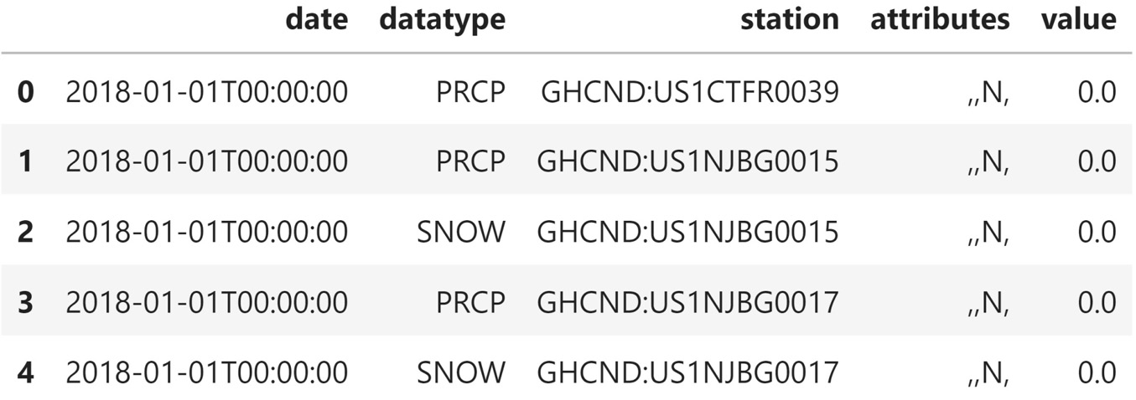
Performing database-style operations on DataFrames
This is long format data—we have several different weather observations per day for various stations covering NYC in 2018:
Notes:
In Working with Pandas DataFrames, we covered how to create dataframes; this was the pandas equivalent of a "CREATE TABLE ..." SQL statement. When we discussed selection and filtering in lesson 2, Working with Pandas DataFrames, and lesson 3, Data Wrangling with Pandas, we were focusing on reading from dataframes, which equated to the SELECT (picking columns) and WHERE (filtering by Boolean criteria) SQL clauses. We carried out update (UPDATE in SQL) and delete (DELETE FROM in SQL) operations when we discussed working with missing data in lesson 3, Data Wrangling with Pandas. In addition to those basic CRUD operations, the concept of a join or merge of tables exists. We will discuss the pandas implementation in this section, along with the idea of querying a DataFrame object.

Slide 5
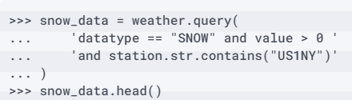
Querying DataFrames
To illustrate this, let's query the weather data for all the rows where the value of the SNOW column was greater than zero for stations with US1NY in their station ID:
Notes:
Pandas provides the query() method so that we can easily write complicated filters instead of using a Boolean mask. The syntax is similar to the WHERE clause in a SQL statement.

Slide 6
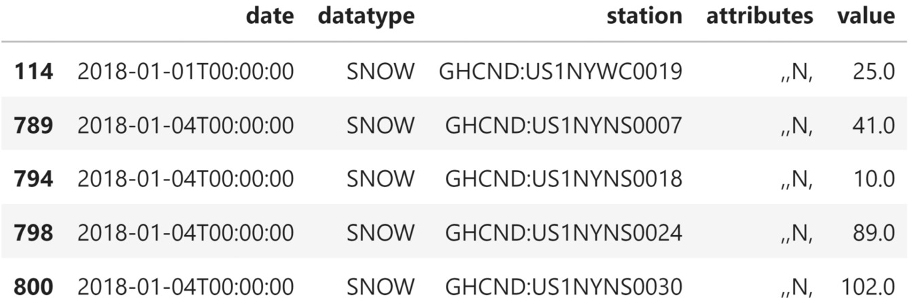
Querying DataFrames
Each row is a snow observation for a given combination of date and station.
Notice that the values vary quite a bit for January 4th—some stations received more snow than others:

Slide 7
Querying DataFrames
This query is equivalent to the following in SQL.
Note that SELECT * selects all the columns in the table (our dataframe, in this case):
SELECT * FROM weather
WHERE
datatype == "SNOW" AND value > 0 AND station LIKE "%US1NY%";

Slide 8
Querying DataFrames
In Working with Pandas DataFrames, we learned how to use a Boolean mask to get the same result:
>>> weather[
... (weather.datatype == 'SNOW') & (weather.value > 0)
... & weather.station.str.contains('US1NY')
... ].equals(snow_data)
True
Notes:
For the most part, which one we use is a matter of preference; however, if we have a long name for our dataframe, we will probably prefer the query() method. In the previous example, we had to type the dataframe's name an additional three times in order to use the mask.
Tip
When using Boolean logic with the query() method, we can use both logical operators (and, or, not) and bitwise operators (&, |, ~).

Slide 9
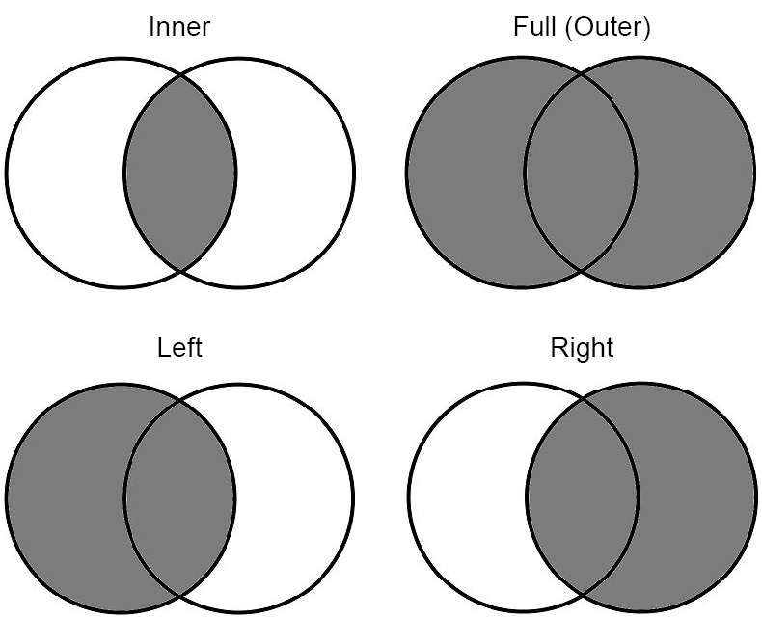
Merging DataFrames
Here, the darker regions represent the data we are left with after performing the join:
Notes:
When we discussed stacking dataframes one on top of the other with the pd.concat() function and the append() method in lesson 2, Working with Pandas DataFrames, we were performing the equivalent of the SQL UNION ALL statement (or just UNION, if we also removed the duplicates, as we saw in lesson 3, Data Wrangling with Pandas). Merging dataframes deals with how to line them up by row.
When referring to databases, merging is traditionally called a join. There are four types of joins: full (outer), left, right, and inner. These join types let us know how the result will be affected by values that are only present on one side of the join. This is a concept that's much more easily understood visually, so let's look at some Venn diagrams and then do some sample joins on the weather data.
We have been working with data from numerous weather stations, but we don't know anything about them besides their IDs. It would be helpful to know exactly where each of the stations is located to better understand discrepancies between weather readings for the same day in NYC. When we queried for the snow data, we saw quite a bit of variation in the readings for January 4th (see Figure 4.3). This is most likely due to the location of the station. Stations at higher elevations or farther north may record more snow. Depending on how far they actually are from NYC, they may have been experiencing a snowstorm that was heavier somewhere else, such as Connecticut or Northern New Jersey.

Slide 10
Merging DataFrames
The NCEI API's stations endpoint gives us all the information we need for the stations.
This is in the weather_stations.csv file, as well as in the stations table in the SQLite database.
Let's read this data into a dataframe:
>>> station_info = pd.read_csv('data/weather_stations.csv')
>>> station_info.head()

Slide 11
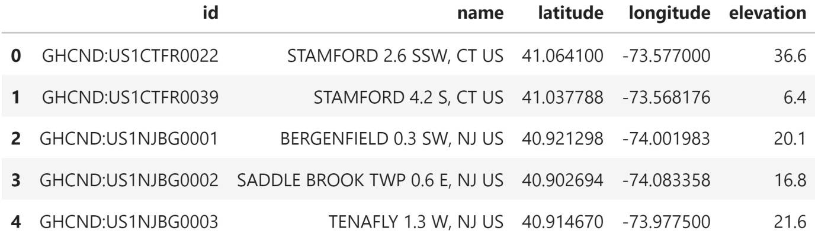
Merging DataFrames
The ones in New Jersey are southwest of NYC, while the ones in Connecticut are northeast of NYC:
Notes:
For reference, Central Park in NYC is at 40.7829° N, 73.9654° W (latitude 40.7829 and longitude -73.9654), and NYC has an elevation of 10 meters. The first five stations that record NYC data are not in New York.

Slide 12
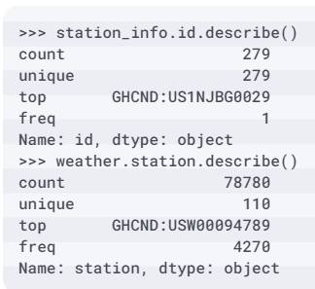
Merging DataFrames
Before we join the data, let's get some information on how many distinct stations we have and how many entries are in each dataframe:
Notes:
Joins require us to specify how to match the data up. The only data the weather dataframe has in common with the station_info dataframe is the station ID. However, the columns containing this information are not named the same: in the weather dataframe, this column is called station, while in the station_info dataframe, it is called id.

Slide 13
Merging DataFrames
To select the rows, we just grab the value at index 0 (1 for columns):
>>> station_info.shape[0], weather.shape[0] # 0=rows, 1=cols
(279, 78780)
Notes:
The difference in the number of unique stations across the dataframes tells us they don't contain all the same stations. Depending on the type of join we pick, we may lose some data. Therefore, it's important to look at the row count before and after the join. We can see this in the count entry from the output of describe(), but we don't need to run that just to get the row count. Instead, we can use the shape attribute, which gives us a tuple of the form (number of rows, number of columns).

Slide 14
Merging DataFrames
Since we will be checking the row count often, it makes more sense to write a function that will give us the row count for any number of dataframes.
The *dfs argument collects all the input to this function in a tuple, which we can iterate over in a list comprehension to get the row count:
>>> def get_row_count(*dfs):
... return [df.shape[0] for df in dfs]
>>> get_row_count(station_info, weather)
[279, 78780]
Notes:
Now that we know that we have 78,780 rows of weather data and 279 rows of station information data, we can begin looking at the types of joins. We'll begin with the inner join, which will result in the least amount of rows (unless the two dataframes have all the same values for the column being joined on, in which case all the joins will be equivalent). The inner join will return the columns from both dataframes where they have a match on the specified key column. Since we will be joining on the weather.station column and the station_info.id column, we will only get weather data for stations that are in station_info.
We will use the merge() method to perform the join (which is an inner join by default) by providing the left and right dataframes, along with specifying which columns to join on. Since the station ID column is named differently across dataframes, we must specify the names with left_on and right_on.

Slide 15
Merging DataFrames
The left dataframe is the one we call merge() on, while the right one is the dataframe that gets passed in as an argument:
>>> inner_join = weather.merge(
... station_info, left_on='station', right_on='id'
... )
>>> inner_join.sample(5, random_state=0)

Slide 16
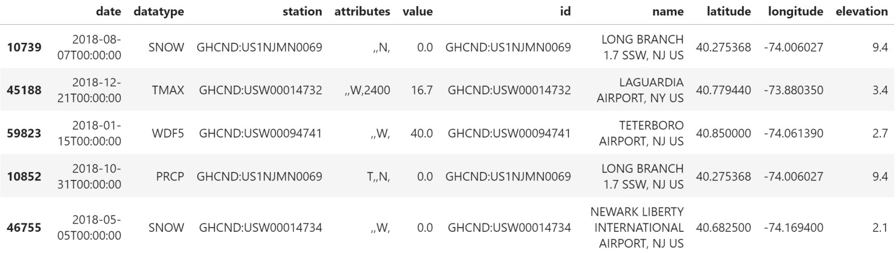
Merging DataFrames
This operation also kept both the station and id columns, which are identical:
Notes:
Notice that we have five additional columns, which have been added to the right. These came from the station_info dataframe.

Slide 17
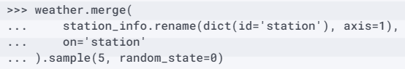
Merging DataFrames
In order to remove the duplicate information in the station and id columns, we can rename one of them before the join.
Consequently, we will only have to supply a value for the on parameter because the columns will share the same name:

Slide 18
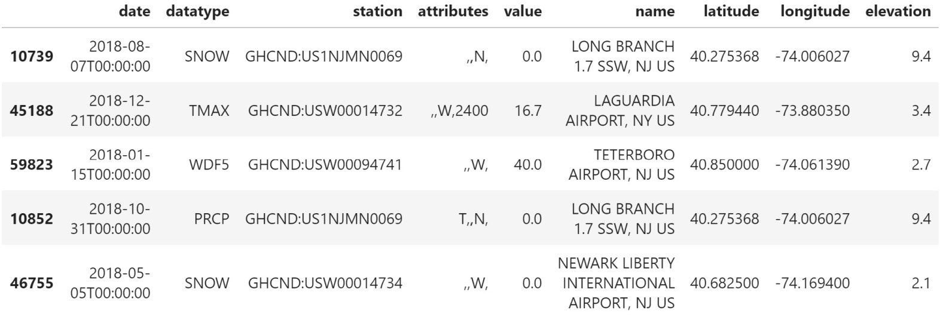
Merging DataFrames
Since the columns shared the name, we only get one back after joining on them:
Notes:
Tip
We can join on multiple columns by passing the list of column names to the on parameter or to the left_on and right_on parameters.
Remember that we had 279 unique stations in the station_info dataframe, but only 110 unique stations for the weather data. When we performed the inner join, we lost all the stations that didn't have weather observations associated with them. If we don't want to lose rows on a particular side of the join, we can perform a left or right join instead.

Slide 19
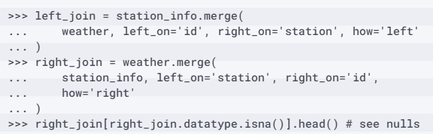
Merging DataFrames
A left join requires us to list the dataframe with the rows that we want to keep (even if they don't exist in the other dataframe) on the left and the other dataframe on the right; a right join is the inverse:
Notes:
Wherever the other dataframe contains no data, we will get null values. We may want to investigate why we don't have any weather data associated with these stations.

Slide 20
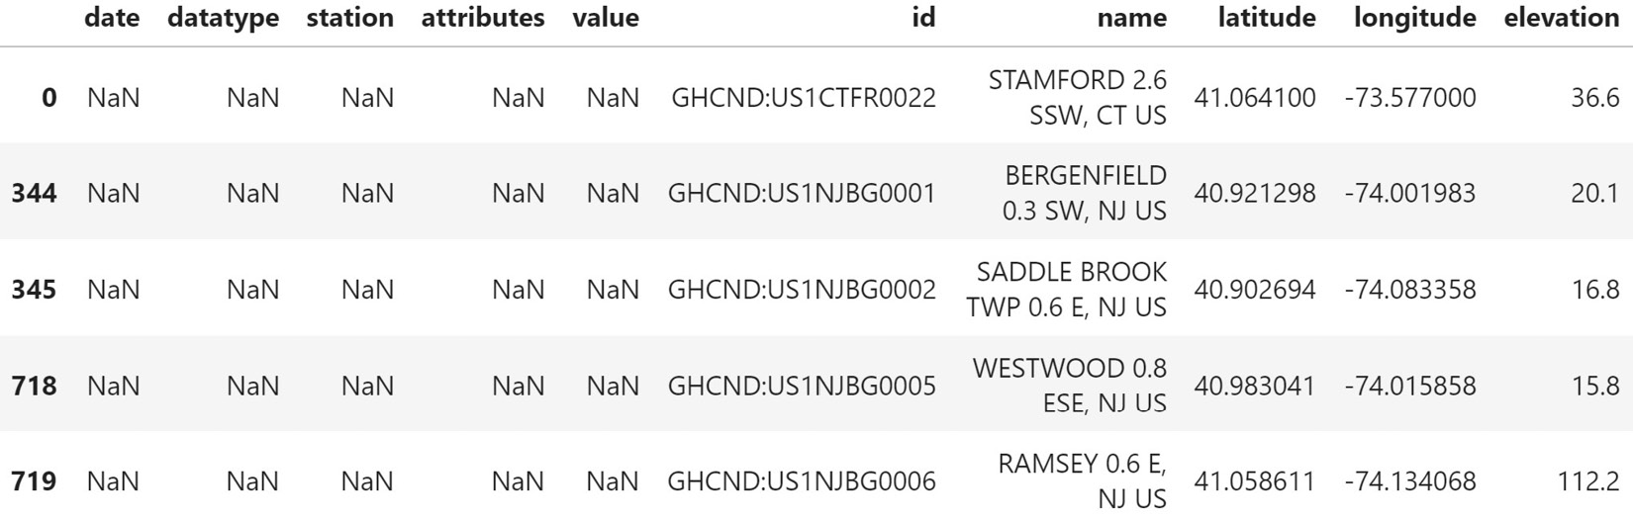
Merging DataFrames
Alternatively, our analysis may involve determining the availability of data per station, so getting null values isn't necessarily an issue:
Notes:
Since we placed the station_info dataframe on the left for the left join and on the right for the right join, the results here are equivalent. In both cases, we chose to keep all the stations present in the station_info dataframe, accepting null values for the weather observations.

Slide 21
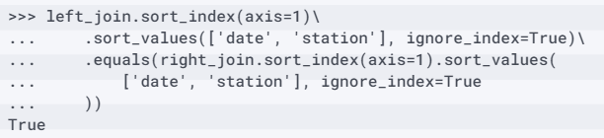
Merging DataFrames
To prove they are equivalent, we need to put the columns in the same order, reset the index, and sort the data:

Slide 22
Merging DataFrames
Note that we have additional rows in the left and right joins because we kept all the stations that didn't have weather observations:
>>> get_row_count(inner_join, left_join, right_join)
[78780, 78949, 78949]
Notes:
The final type of join is a full outer join, which will keep all the values, regardless of whether or not they exist in both dataframes. For instance, say we queried for stations with US1NY in their station ID because we believed that stations measuring NYC weather would have to be labeled as such. This means that an inner join would result in losing observations from the stations in Connecticut and New Jersey, while a left/right join would result in either lost station information or lost weather data. The outer join will preserve all the data.

Slide 23
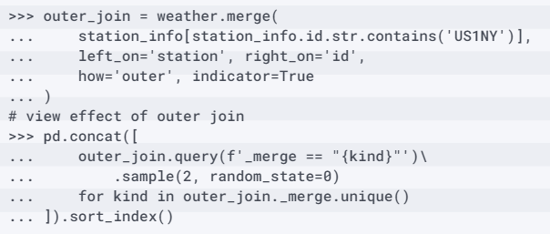
Merging DataFrames
We will also pass in indicator=True to add an additional column to the resulting dataframe, which will indicate which dataframe each row came from:
Notes:
Indices 23634 and 25742 come from stations located in New York, and the match gives us information about the station. Indices 60645 and 70764 are for stations that don't have US1NY in their station ID, causing nulls for the station information columns. The bottom two rows are stations in New York that aren't providing weather observations for NYC.

Slide 24
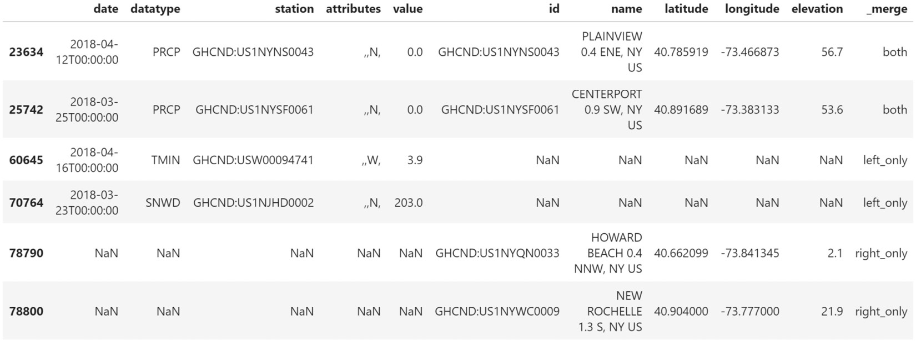
Merging DataFrames
This join keeps all the data and will often introduce null values, unlike inner joins, which won't:

Slide 25
Merging DataFrames
The aforementioned joins are equivalent to SQL statements of the following form, where we simply change <JOIN_TYPE> to (INNER) JOIN, LEFT JOIN, RIGHT JOIN, or FULL OUTER JOIN for the appropriate join:
SELECT *
FROM left_table
<JOIN_TYPE> right_table
ON left_table.<col> == right_table.<col>;
Notes:
Joining dataframes makes working with the dirty data in lesson 3, Data Wrangling with Pandas, easier. Remember, we had data from two distinct stations: one had a valid station ID and the other was ?. The ? station was the only one recording the water equivalent of snow (WESF). Now that we know about joining dataframes, we can join the data from the valid station ID to the data from the ? station that we are missing by date. First, we will need to read in the CSV file, setting the date column as the index.

Slide 26
Merging DataFrames
We will drop the duplicates and the SNWD column (snow depth), which we found to be uninformative since most of the values were infinite (both in the presence and absence of snow):
>>> dirty_data = pd.read_csv(
... 'data/dirty_data.csv', index_col='date'
... ).drop_duplicates().drop(columns='SNWD')
>>> dirty_data.head()

Slide 27
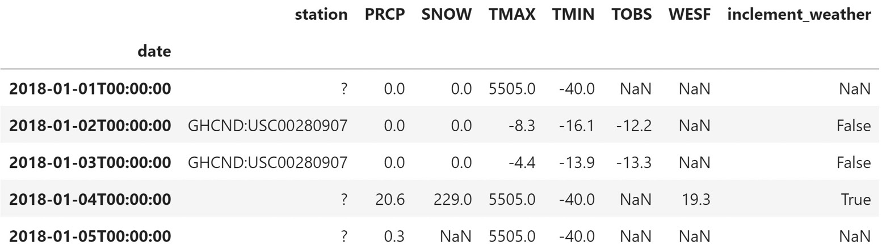
Merging DataFrames
Our starting data looks like this:

Slide 28
Merging DataFrames
Now, we need to create a dataframe for each station.
To reduce output, we will drop some additional columns:
>>> valid_station = dirty_data.query('station != "?"')\
... .drop(columns=['WESF', 'station'])
>>> station_with_wesf = dirty_data.query('station == "?"')\
... .drop(columns=['station', 'TOBS', 'TMIN', 'TMAX'])
Notes:
This time, the column we want to join on (the date) is actually the index, so we will pass in left_index to indicate that the column to use from the left dataframe is the index, and then right_index to indicate the same for the right dataframe.

Slide 29
Merging DataFrames
We will perform a left join to make sure we don't lose any rows from our valid station, and, where possible, augment them with the observations from the ? station:
>>> valid_station.merge(
... station_with_wesf, how='left',
... left_index=True, right_index=True
... ).query('WESF > 0').head()
Notes:
For all the columns that the dataframes had in common, but weren't part of the join, we have two versions now.

Slide 30
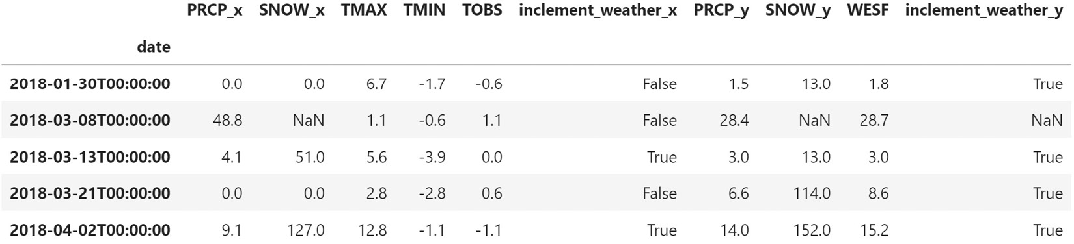
Merging DataFrames
The versions coming from the left dataframe have the _x suffix appended to the column names, and those coming from the right dataframe have _y as the suffix:

Slide 31
Merging DataFrames
We can provide our own suffixes with the suffixes parameter.
Let's use a suffix for the ? station only:
>>> valid_station.merge(
... station_with_wesf, how='left',
... left_index=True, right_index=True,
... suffixes=('', '_?')
... ).query('WESF > 0').head()
Notes:
Since we specified an empty string for the left suffix, the columns coming from the left dataframe have their original names.

Slide 32
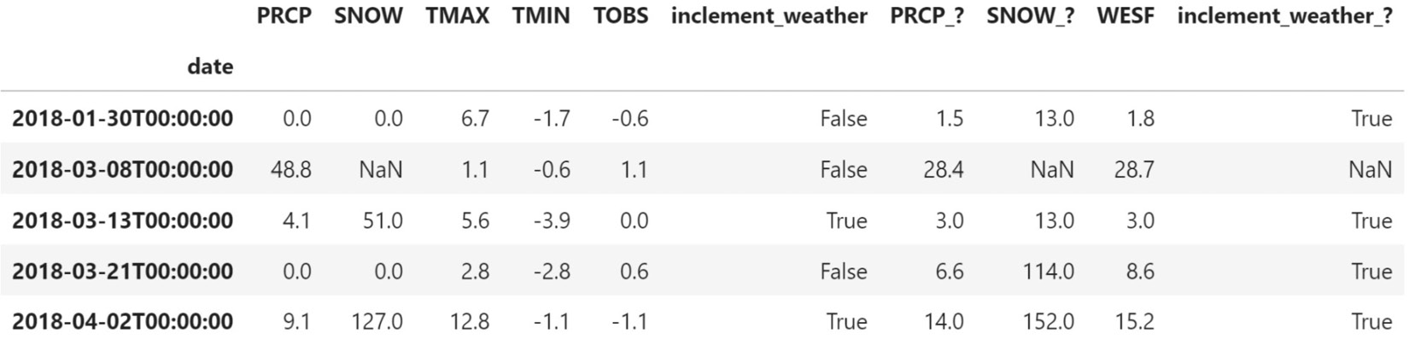
Merging DataFrames
However, the right suffix of _? was added to the names of the columns that came from the right dataframe:
Notes:
When we are joining on the index, an easier way to do this is to use the join() method instead of merge(). It also defaults to an inner join, but this behavior can be changed with the how parameter, just like with merge(). The join() method will always use the index of the left dataframe to join, but it can use a column in the right dataframe if its name is passed to the on parameter. Note that suffixes are now specified using lsuffix for the left dataframe's suffix and rsuffix for the right one.

Slide 33
Merging DataFrames
This yields the same result as the previous example:
>>> valid_station.join(
... station_with_wesf, how='left', rsuffix='_?'
... ).query('WESF > 0').head()
Notes:
One important thing to keep in mind is that joins can be rather resource-intensive, so it is often beneficial to figure out what will happen to the rows before going through with it. If we don't already know what type of join we want, this can help give us an idea. We can use set operations on the index we plan to join on to figure this out.

Slide 34
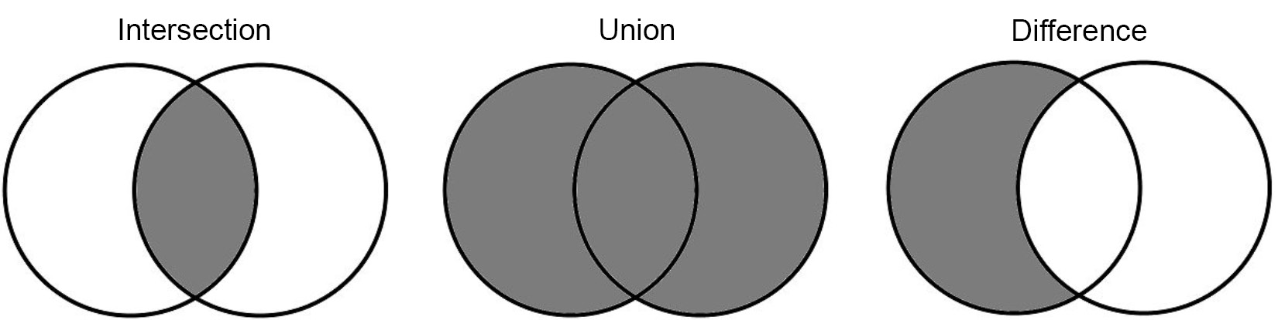
Merging DataFrames
Remember that the mathematical definition of a set is a collection of distinct objects.
By definition, the index is a set. Set operations are often explained with Venn diagrams:
Notes:
Important note
Note that set is also a Python type that's available in the standard library. A common use of sets is to remove duplicates from a list. More information on sets in Python can be found in the documentation at https://docs.python.org/3/library/stdtypes.html#set-types-set-frozenset.

Slide 35
Merging DataFrames
Let's use the weather and station_info dataframes to illustrate set operations.
First, we must set the index to the column(s) that will be used for the join operation:
>>> weather.set_index('station', inplace=True)
>>> station_info.set_index('id', inplace=True)

Slide 36
Merging DataFrames
To see what will remain with an inner join, we can take the intersection of the indices, which shows us the overlapping stations:
>>> weather.index.intersection(station_info.index)
Index(['GHCND:US1CTFR0039', ..., 'GHCND:USW1NYQN0029'],
dtype='object', length=110)
Notes:
As we saw when we ran the inner join, we only got station information for the stations with weather observations. This doesn't tell us what we lost, though; for this, we need to find the set difference, which will subtract the sets and give us the values of the first index that aren't in the second.

Slide 37
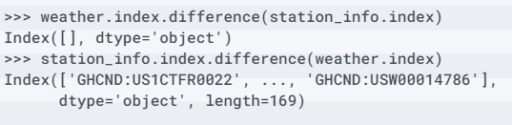
Merging DataFrames
With the set difference, we can easily see that, when performing an inner join, we don't lose any rows from the weather data, but we lose 169 stations that don't have weather observations:
Notes:
Note that this output also tells us how left and right joins will turn out. To avoid losing rows, we want to put the station_info dataframe on the same side as the join (on the left for a left join and on the right for a right join).
Tip
We can use the symmetric_difference() method on the indices of the dataframes involved in the join to see what will be lost from both sides: index_1.symmetric_difference(index_2). The result will be the values that are only in one of the indices. An example is in the notebook.
Lastly, we can use the union to view all the values we will keep if we run a full outer join.

Slide 38
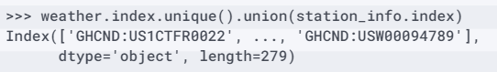
Merging DataFrames
Remember, the weather dataframe contains the stations repeated throughout because they provide daily measurements, so we call the unique() method before taking the union to see the number of stations we will keep:
Notes:
The Further reading section at the end of this lesson contains some resources on set operations and how pandas compares to SQL. For now, let's move on to data enrichment.

Slide 39
Using DataFrame operations to enrich data
Let's import what we will need and read in the data:
>>> import numpy as np
>>> import pandas as pd
>>> weather = pd.read_csv(
... 'data/nyc_weather_2018.csv', parse_dates=['date']
... )
>>> fb = pd.read_csv(
... 'data/fb_2018.csv', index_col='date', parse_dates=True
... )
Notes:
Now that we've discussed how to query and merge DataFrame objects, let's learn how to perform complex operations on them to create and modify columns and rows. For this section, we will be working in the 2-dataframe_operations.ipynb notebook using the weather data, along with Facebook stock's volume traded and opening, high, low, and closing prices daily for 2018.
We will begin by reviewing operations that summarize entire rows and columns before moving on to binning, applying functions across rows and columns, and window calculations, which summarize data along a certain number of observations at a time (such as moving averages).

Slide 40
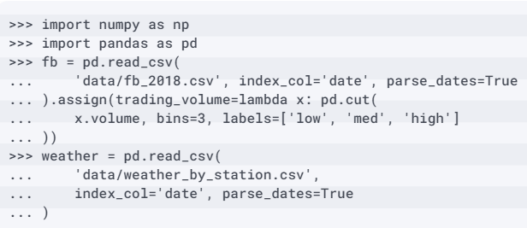
Aggregating data
For this section, we will be working in the 3-aggregations.ipynb notebook.
Let's import pandas and numpy and read in the data we will be working with:
Notes:
Here, we will focus on summarizing the dataframe through aggregation, which will change the shape of our dataframe (often through row reduction). We also saw how easy it is to take advantage of vectorized NumPy functions on pandas data structures, especially to perform aggregations. This is what NumPy does best: it performs computationally efficient mathematical operations on numeric arrays.
NumPy pairs well with aggregating dataframes since it gives us an easy way to summarize data with different pre-written functions; often, when aggregating, we just need the NumPy function, since most of what we would want to write ourselves has previously been built. We have already seen some NumPy functions commonly used for aggregations, such as np.sum(), np.mean(), np.min(), and np.max(); however, we aren't limited to numeric operations—we can use things such as np.unique() on strings. Always check whether NumPy already has a function before implementing one yourself.

Slide 41
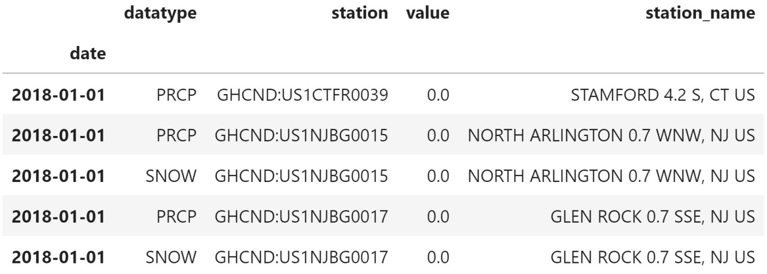
Aggregating data
Note that the weather data for this section has been merged with some of the station data:

Slide 42
Aggregating data
Before we dive into any calculations, let's make sure that our data won't be displayed in scientific notation.
We will modify how floats are formatted for displaying.
The format we will apply is .2f, which will provide the float with two digits after the decimal point:
>>> pd.set_option('display.float_format', lambda x: '%.2f' % x)
Notes:
First, we will take a look at summarizing the full dataset before moving on to summarizing by groups and building pivot tables and crosstabs.

Slide 43
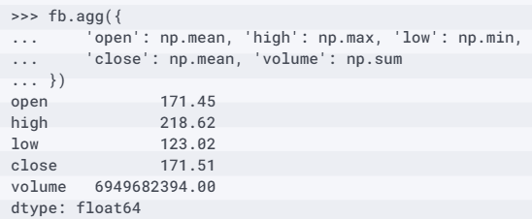
Summarizing DataFrames
Note that we won't get anything back for the trading_volume column, which contains the volume traded bins from pd.cut(); this is because we aren't specifying an aggregation to run on that column:
Notes:
When we discussed window calculations, we saw that we could run the agg() method on the result of rolling(), expanding(), or ewm(); however, we can also call it directly on the dataframe in the same fashion. The only difference is that the aggregations done this way will be performed on all the data, meaning that we will only get a series back that contains the overall result. Let's aggregate the Facebook stock data the same way we did with the window calculations.

Slide 44
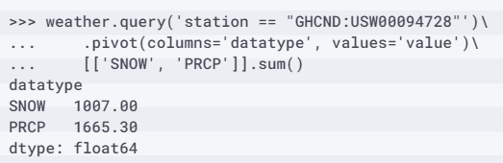
Summarizing DataFrames
In this case, since we will be performing the sum on both, we can either use agg('sum') or call sum() directly:
Notes:
We can use aggregations to easily find the total snowfall and precipitation for 2018 in Central Park.

Slide 45
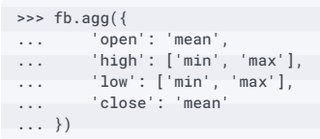
Summarizing DataFrames
The index of this dataframe will tell us which metric is being calculated for which column:
Notes:
Additionally, we can provide multiple functions to run on each of the columns we want to aggregate. As we have already seen, we get a Series object when each column has a single aggregation. To distinguish between the aggregations in the case of multiple ones per column, pandas will return a DataFrame object instead.

Slide 46
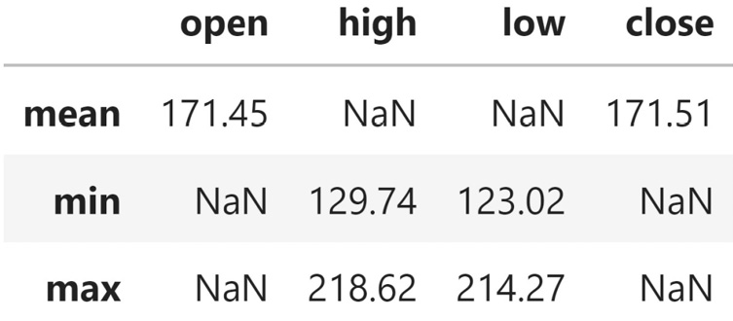
Summarizing DataFrames
This results in a dataframe where the rows indicate the aggregation function being applied to the data columns.
Note that we get nulls for any combination of aggregation and column that we didn't explicitly ask for:
Notes:
So far, we have learned how to aggregate over specific windows and over the entire dataframe; however, the real power comes with the ability to aggregate by group membership. This lets us calculate things such as the total precipitation per month, per station and average OHLC stock prices for each volume traded bin we've created.

Slide 47
Aggregating by group
To calculate the aggregations per group, we must first call the groupby() method on the dataframe and provide the column(s) we want to use to determine distinct groups.
Let's look at the average of our stock data points for each of the volume traded bins we created with pd.cut(); remember, these are three equal-width bins:
>>> fb.groupby('trading_volume').mean()

Slide 48
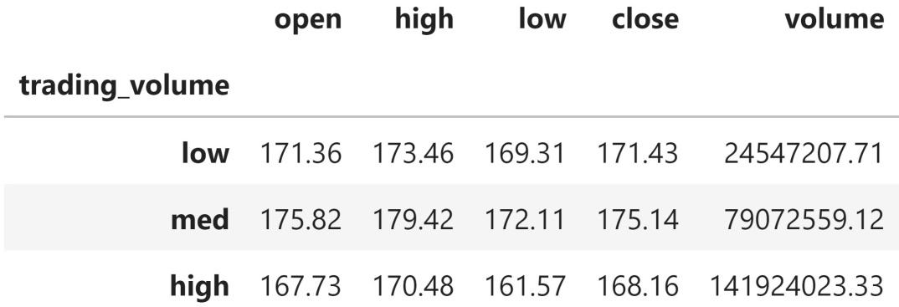
Aggregating by group
The average OHLC prices are smaller for larger trading volumes, which was to be expected given that the three dates in the high-volume traded bin were selloffs:

Slide 49
Aggregating by group
After running groupby(), we can also select specific columns for aggregation:
>>> fb.groupby('trading_volume')\
... ['close'].agg(['min', 'max', 'mean'])

Slide 50
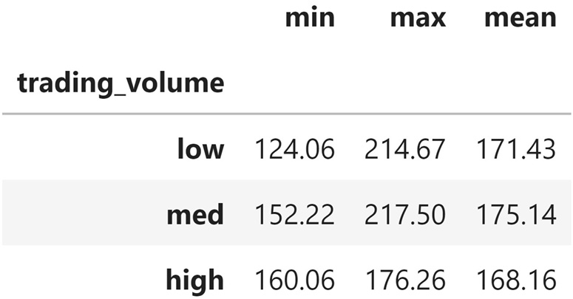
Aggregating by group
This gives us the aggregations for the closing price in each volume traded bucket:

Slide 51
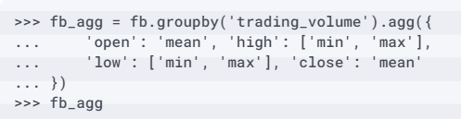
Aggregating by group
As we did previously, we can provide lists of functions per column; the result, however, will look a little different:
Notes:
If we need more fine-tuned control over how each column gets aggregated, we use the agg() method again with a dictionary that maps the columns to their aggregation function.

Slide 52
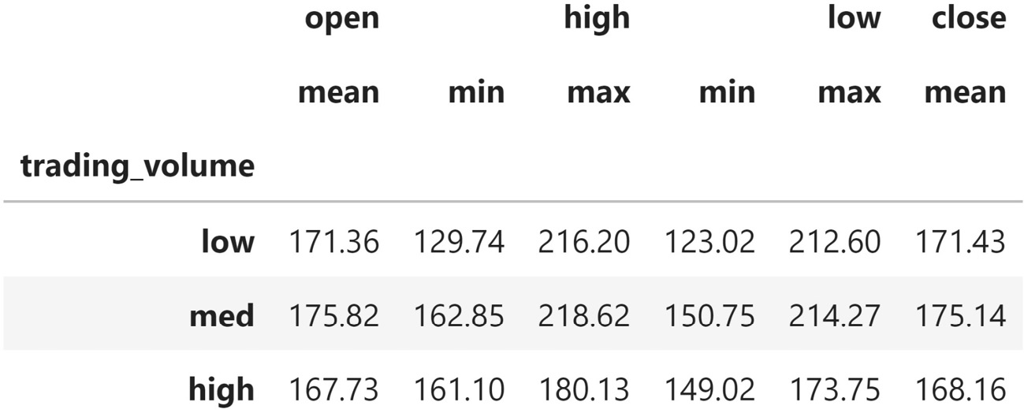
Aggregating by group
We now have a hierarchical index in the columns.
Remember, this means that if we want to select the minimum low price for the medium volume traded bucket, we need to use fb_agg.loc['med', 'low']['min']:

Slide 53
Aggregating by group
The columns are stored in a MultiIndex object:
>>> fb_agg.columns
MultiIndex([( 'open', 'mean'),
( 'high', 'min'),
( 'high', 'max'),
( 'low', 'min'),
( 'low', 'max'),
('close', 'mean')],
)

Slide 54
Aggregating by group
We can use a list comprehension to remove this hierarchy and instead have our column names in the form of <column>_<agg>.
At each iteration, we will get a tuple of the levels from the MultiIndex object, which we can combine into a single string to remove the hierarchy:
>>> fb_agg.columns = ['_'.join(col_agg)
... for col_agg in fb_agg.columns]
>>> fb_agg.head()

Slide 55
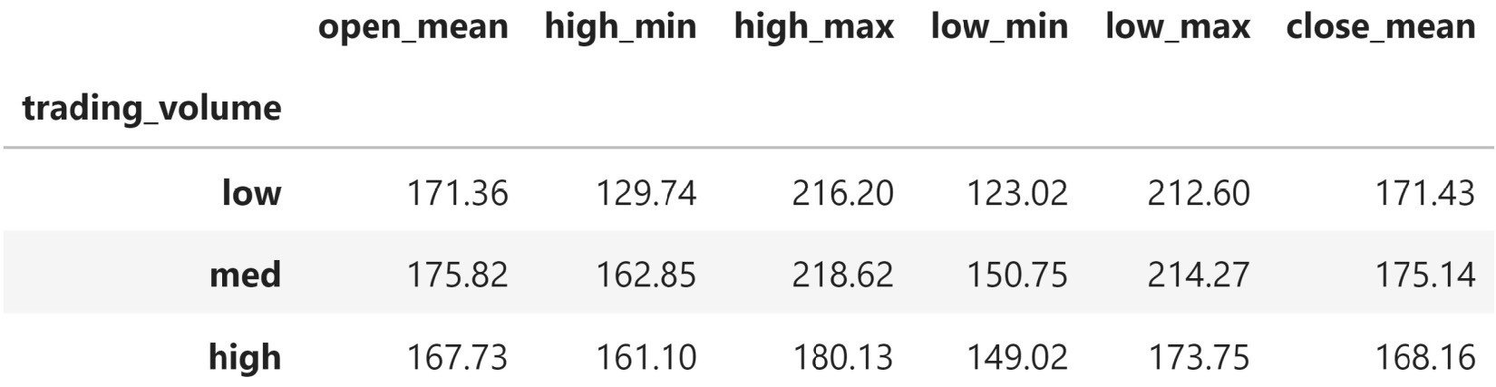
Aggregating by group
This replaces the hierarchy in the columns with a single level:
Notes:
Say we want to see the average observed precipitation across all the stations per day. We would need to group by the date, but it is in the index. In this case, we have a few options:
Resampling, which we will cover in the Working with time series data section, later in this lesson.
Resetting the index and using the date column that gets created from the index.
Passing level=0 to groupby() to indicate that the grouping should be performed on the outermost level of the index.
Using a Grouper object.
Here, we will pass level=0 to groupby(), but note that we can also pass in level='date' because our index is named. This gives us the average precipitation observations across the stations, which may give us a better idea of the weather than simply picking a station to look at.

Slide 56
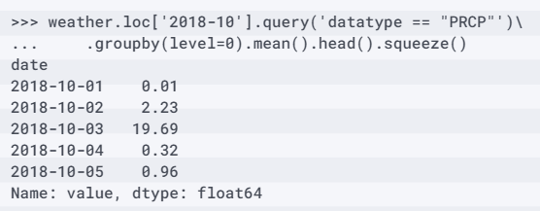
Aggregating by group
Since the result is a single-column DataFrame object, we call squeeze() to turn it into a Series object:

Slide 57
Aggregating by group
Since this will create a multi-level index, we will also use unstack() to put the inner level (the quarter) along the columns after the aggregation is performed:
>>> weather.query('datatype == "PRCP"').groupby(
... ['station_name', pd.Grouper(freq='Q')]
... ).sum().unstack().sample(5, random_state=1)
Notes:
We can also group by many categories at once. Let's find the quarterly total recorded precipitation per station. Here, rather than pass in level=0 to groupby(), we need to use a Grouper object to aggregate from daily to quarterly frequency.

Slide 58
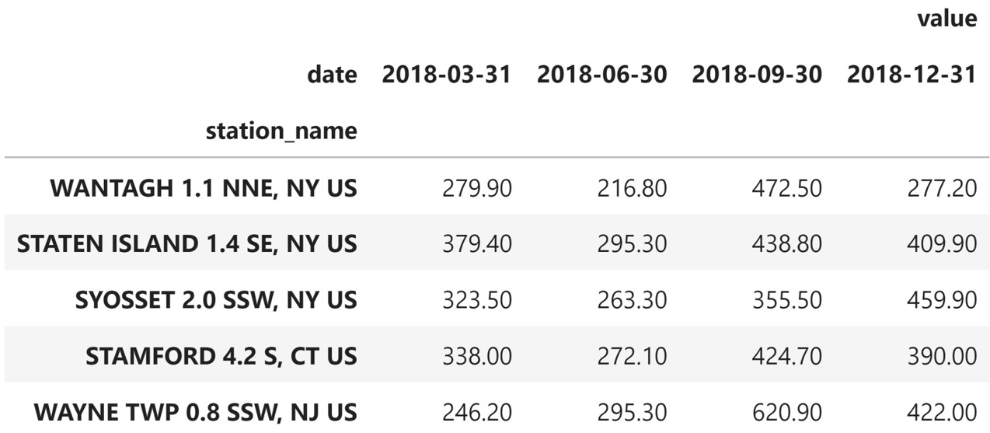
Aggregating by group
We could also see which quarter has the most/least precipitation across the stations:
Notes:
There are many possible follow-ups for this result. We could look at which stations receive the most/least precipitation. We could go back to the location and elevation information we had for each station to see if that affects precipitation.
Tip
The DataFrameGroupBy objects returned by the groupby() method have a filter() method, which allows us to filter groups. We can use this to exclude certain groups from the aggregation. Simply pass a function that returns a Boolean for each group's subset of the dataframe (True to include the group and False to exclude it). An example is in the notebook.
Let's see which months have the most precipitation. First, we need to group by day and average the precipitation across the stations. Then, we can group by month and sum the resulting precipitation.

Slide 59
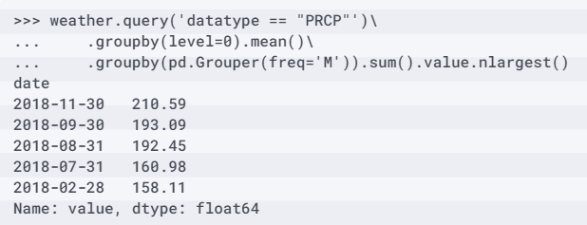
Aggregating by group
Finally, we will use nlargest() to get the five months with the most precipitation:
Notes:
Perhaps the previous result was surprising. The saying goes April showers bring May flowers; however, April wasn't in the top five (neither was May, for that matter). Snow will count toward precipitation, but that doesn't explain why summer months are higher than April. Let's look for days that accounted for a large percentage of the precipitation in a given month to see if April shows up there.
To do so, we need to calculate the average daily precipitation across stations and then find the total per month; this will be the denominator. However, in order to divide the daily values by the total for their month, we will need a Series object of equal dimensions. This means that we will need to use the transform() method, which will perform the specified calculation on the data while always returning an object of equal dimensions to what we started with.

Slide 60
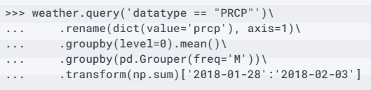
Aggregating by group
Therefore, we can call it on a Series object and always get a Series object back, regardless of what the aggregation function itself would return:

Slide 61
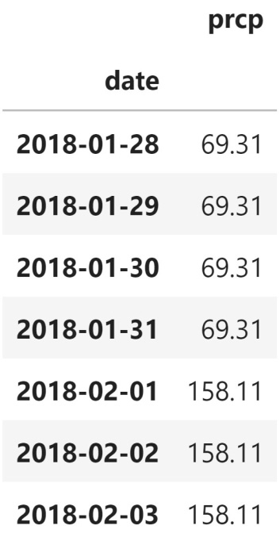
Aggregating by group
Rather than getting a single sum for January and another for February, notice that we have the same value being repeated for the January entries and a different one for the February ones.
Note that the value for February is the value we found in the previous result:

Slide 62
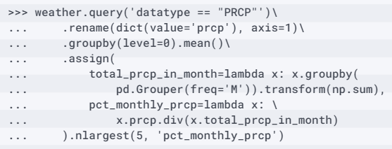
Aggregating by group
We can make this a column in our dataframe to easily calculate the percentage of the monthly precipitation that occurred each day.
Then, we can use nlargest() to pull out the largest values:

Slide 63
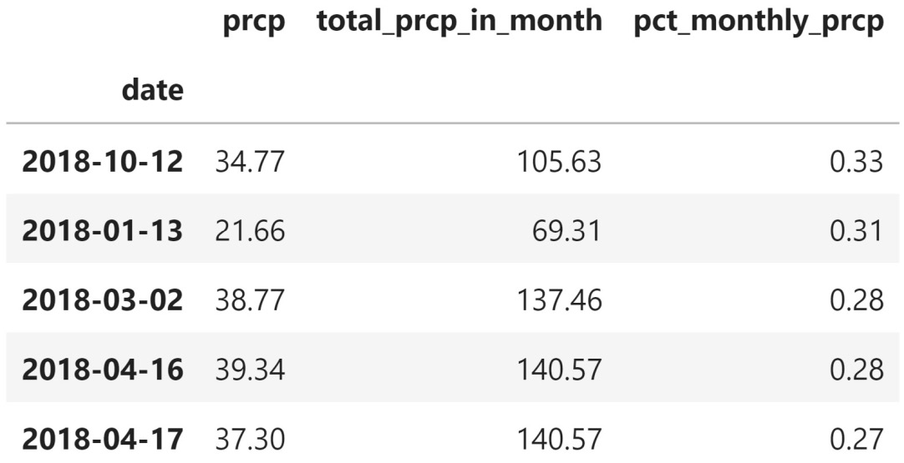
Aggregating by group
They were also consecutive days:
Notes:
Together, the 4th- and 5th-place days in terms of the amount of monthly precipitation they accounted for make up more than 50% of the rain in April.
Important note
The transform() method also works on DataFrame objects, in which case it will return a DataFrame object. We can use it to easily standardize all the columns at once. An example is in the notebook.

Slide 64
Pivot tables and crosstabs
Let's create a pivot table of averaged OHLC data for Facebook per volume traded bin:
>>> fb.pivot_table(columns='trading_volume')
Notes:
To wrap up this section, we will discuss some pandas functions that will aggregate our data into some common formats. The aggregation methods we discussed previously will give us the highest level of customization; however, pandas provides some functions to quickly generate a pivot table and a crosstab in a common format.
In order to generate a pivot table, we must specify what to group on and, optionally, which subset of columns we want to aggregate and/or how to aggregate (average, by default).
Since we passed in columns='trading_volume', the distinct values in the trading_volume column were placed along the columns. The columns from the original dataframe then went to the index.

Slide 65
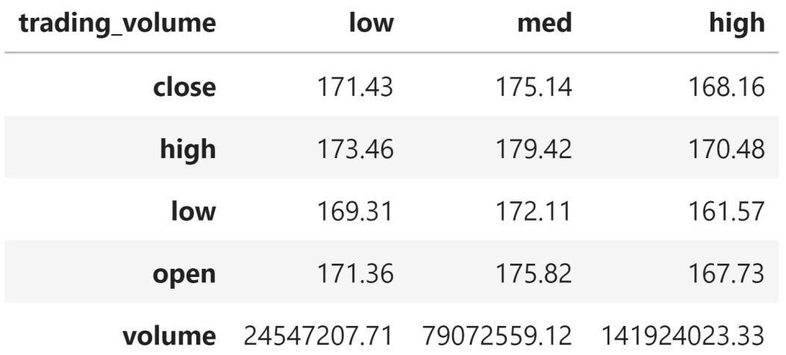
Pivot tables and crosstabs
Notice that the index for the columns has a name (trading_volume):
Notes:
Tip
If we pass trading_volume as the index argument instead, we get the transpose of Figure 4.42, which is also the exact same output as Figure 4.35 when we used groupby().
With the pivot() method, we weren't able to handle multi-level indices or indices with repeated values. For this reason, we haven't been able to put the weather data in wide format. The pivot_table() method solves this issue. To do so, we need to put the date and station information in the index and the distinct values of the datatype column along the columns. The values will come from the value column.

Slide 66
Pivot tables and crosstabs
We will use the median to aggregate any overlapping combinations (if any):
>>> weather.reset_index().pivot_table(
... index=['date', 'station', 'station_name'],
... columns='datatype',
... values='value',
... aggfunc='median'
... ).reset_index().tail()

Slide 67
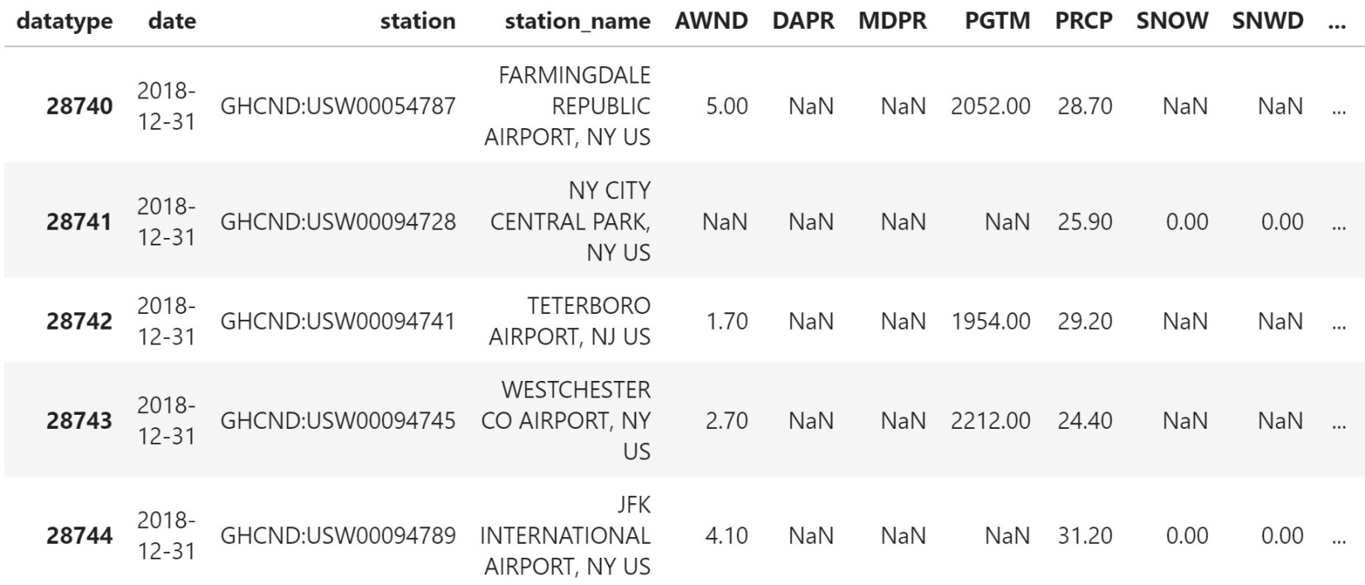
Pivot tables and crosstabs
After resetting the index, we have our data in wide format.
One final step would be to rename the index:

Slide 68
Pivot tables and crosstabs
By default, the values in the cells will be the count:
>>> pd.crosstab(
... index=fb.trading_volume, columns=fb.index.month,
... colnames=['month'] # name the columns index
... )
Notes:
We can use the pd.crosstab() function to create a frequency table. For example, if we want to see how many low-, medium-, and high-volume trading days Facebook stock had each month, we can use a crosstab. The syntax is pretty straightforward; we pass the row and column labels to the index and columns parameters, respectively.

Slide 69
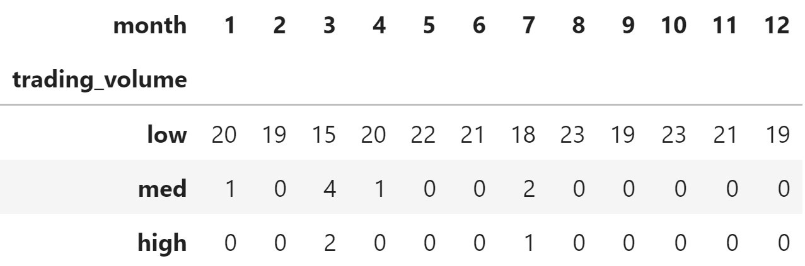
Pivot tables and crosstabs
This makes it easy to see the months when high volumes of Facebook stock were traded:
Notes:
Tip
We can normalize the output to percentages of the row/column totals by passing in normalize='rows'/normalize='columns'. An example is in the notebook.
To change the aggregation function, we can provide an argument to values and then specify aggfunc.

Slide 70
Pivot tables and crosstabs
To illustrate this, let's find the average closing price of each trading volume bucket per month instead of the count in the previous example:
>>> pd.crosstab(
... index=fb.trading_volume, columns=fb.index.month,
... colnames=['month'], values=fb.close, aggfunc=np.mean
... )

Slide 71
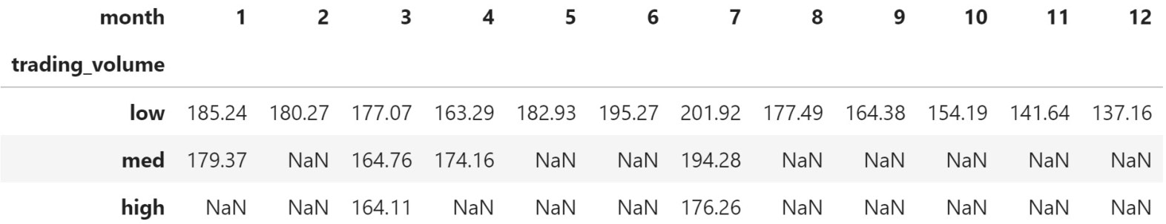
Pivot tables and crosstabs
We now get the average closing price per month, per volume traded bin, with null values when that combination wasn't present in the data:
Notes:
We can also get row and column subtotals with the margins parameter.

Slide 72
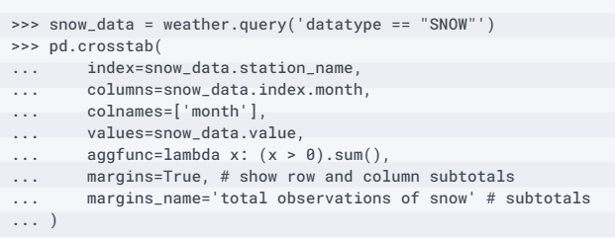
Pivot tables and crosstabs
Let's count the number of times each station recorded snow per month and include the subtotals:

Slide 73
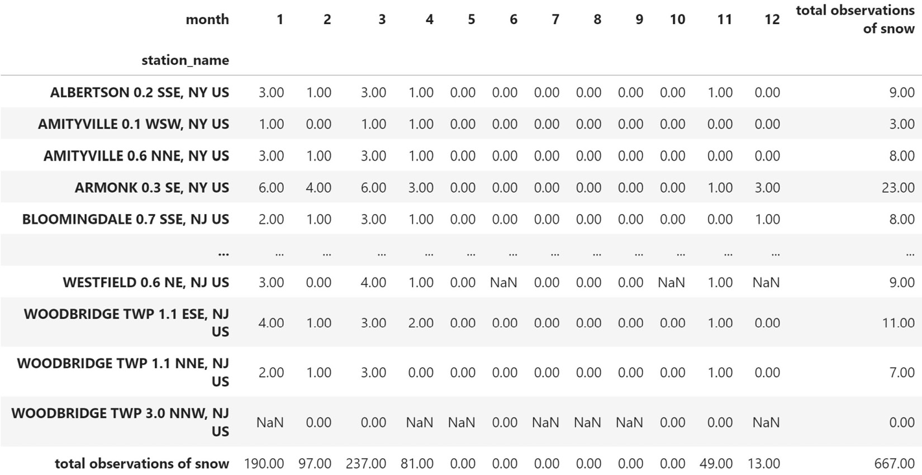
Pivot tables and crosstabs
Along the bottom row, we have the total snow observations per month, while down the rightmost column, we have the total snow observations in 2018 per station:
Notes:
Just by looking at a few stations, we can see that, despite all of them supplying weather information for NYC, they don't share every facet of the weather. Depending on which stations we choose to look at, we could be adding/subtracting snow from what really happened in NYC.

Slide 74
Working with time series data
Let's start off by reading in the Facebook data from the previous sections:
>>> import numpy as np
>>> import pandas as pd
>>> fb = pd.read_csv(
... 'data/fb_2018.csv', index_col='date', parse_dates=True
... ).assign(trading_volume=lambda x: pd.cut(
... x.volume, bins=3, labels=['low', 'med', 'high']
... ))
Notes:
With time series data, we have some additional operations we can use, for anything from selection and filtering to aggregation. We will be exploring some of this functionality in the 4-time_series.ipynb notebook.
We will begin this section by discussing the selection and filtering of time series data before moving on to shifting, differencing, resampling, and finally merging based on time. Note that it's important to set the index to our date (or datetime) column, which will allow us to take advantage of the additional functionality we will be discussing. Some operations may work without doing this, but for a smooth process throughout our analysis, using an index of type DatetimeIndex is recommended.

Slide 75
Time-based selection and filtering
Let's start with a quick recap of datetime slicing and indexing.
We can easily isolate data for the year by indexing on it: fb.loc['2018’].
In the case of our stock data, the full dataframe would be returned because we only have 2018 data; however, we can filter to a month (fb.loc['2018-10']) or to a range of dates.
Note that using loc[] is optional with ranges:
>>> fb['2018-10-11':'2018-10-15']

Slide 76
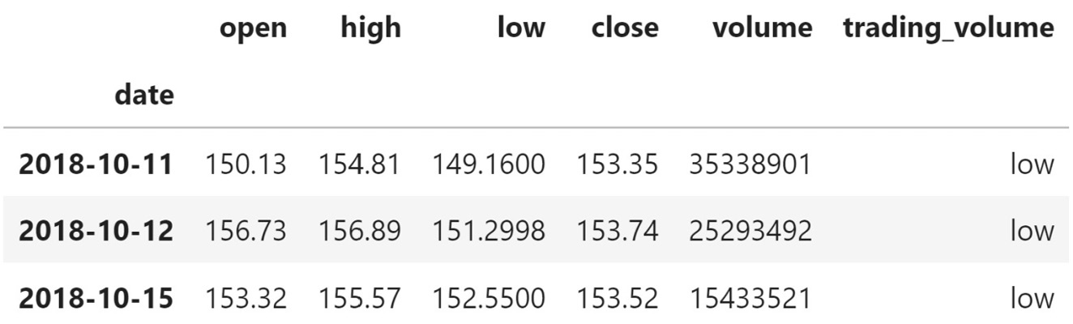
Time-based selection and filtering
We only get three days back because the stock market is closed on the weekends:

Slide 77
Time-based selection and filtering
Keep in mind that the date range can also be supplied using other frequencies, such as month or the quarter of the year:
>>> fb.loc['2018-q1'].equals(fb['2018-01':'2018-03'])
True

Slide 78
Time-based selection and filtering
When targeting the beginning or end of a date range, pandas has some additional methods for selecting the first or last rows within a specified unit of time.
We can select the first week of stock prices in 2018 using the first() method and an offset of 1W:
>>> fb.first('1W')

Slide 79
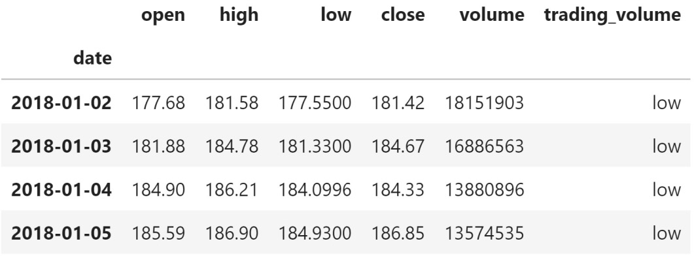
Time-based selection and filtering
January 1, 2018 was a holiday, meaning that the market was closed.
It was also a Monday, so the week here is only four days long:

Slide 80
Time-based selection and filtering
We can perform a similar operation for the most recent dates as well.
Selecting the last week in the data is as simple as switching the first() method with the last() method:
>>> fb.last('1W')

Slide 81
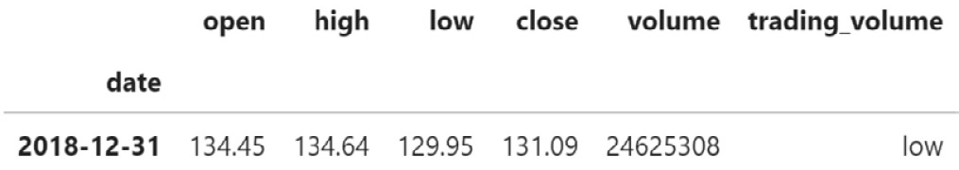
Time-based selection and filtering
Since December 31, 2018 was a Monday, the last week only consists of one day:

Slide 82
Time-based selection and filtering
When working with daily stock data, we only have data for the dates the stock market was open.
Suppose that we reindexed the data to include rows for each day of the year:
>>> fb_reindexed = fb.reindex(
... pd.date_range('2018-01-01', '2018-12-31', freq='D')
... )

Slide 83
Time-based selection and filtering
Here, we will also use the squeeze() method to turn the 1-row DataFrame object resulting from the call to first('1D').isna() into a Series object so that calling all() yields a single value:
>>> fb_reindexed.first('1D').isna().squeeze().all()
True
Notes:
The reindexed data would have all nulls for January 1st and any other days the market was closed. We can combine the first(), isna(), and all() methods to confirm this.

Slide 84
Time-based selection and filtering
For the first quarter of 2018, the first day of trading was January 2nd and the last was March 29th:
>>> fb_reindexed.loc['2018-Q1'].first_valid_index()
Timestamp('2018-01-02 00:00:00', freq='D')
>>> fb_reindexed.loc['2018-Q1'].last_valid_index()
Timestamp('2018-03-29 00:00:00', freq='D')
Notes:
We can use the first_valid_index() method to obtain the index of the first non-null entry in our data, which will be the first day of trading in the data. To obtain the last day of trading, we can use the last_valid_index() method.

Slide 85
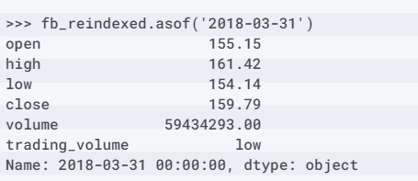
Time-based selection and filtering
Therefore, if we wanted to see how Facebook performed on the last day in each month, we could use asof(), and avoid having to first check if the market was open that day:
Notes:
If we wanted to know what Facebook's stock price looked like as of March 31, 2018, our initial idea may be to use indexing to retrieve it. However, if we try to do so with loc[] (fb_reindexed.loc['2018-03-31']), we will get null values because the stock market wasn't open that day. If we use the asof() method instead, it will give us the closest non-null data that precedes the date we ask for, which in this case is March 29th.

Slide 86
Time-based selection and filtering
>>> stock_data_per_minute = pd.read_csv(
... 'data/fb_week_of_may_20_per_minute.csv',
... index_col='date', parse_dates=True,
... date_parser=lambda x: \
... pd.to_datetime(x, format='%Y-%m-%d %H-%M')
... )
>>> stock_data_per_minute.head()
Notes:
For the next few examples, we will need time information in addition to the date. The datasets we have been working with thus far lack a time component, so we will switch to the Facebook stock data by the minute from May 20, 2019 through May 24, 2019 from Nasdaq.com. In order to properly parse the datetimes, we need to pass in a lambda function as the date_parser argument since they are not in a standard format (for instance, May 20, 2019 at 9:30 AM is represented as 2019-05-20 09-30); the lambda function will specify how to convert the data in the date field into datetimes:

Slide 87
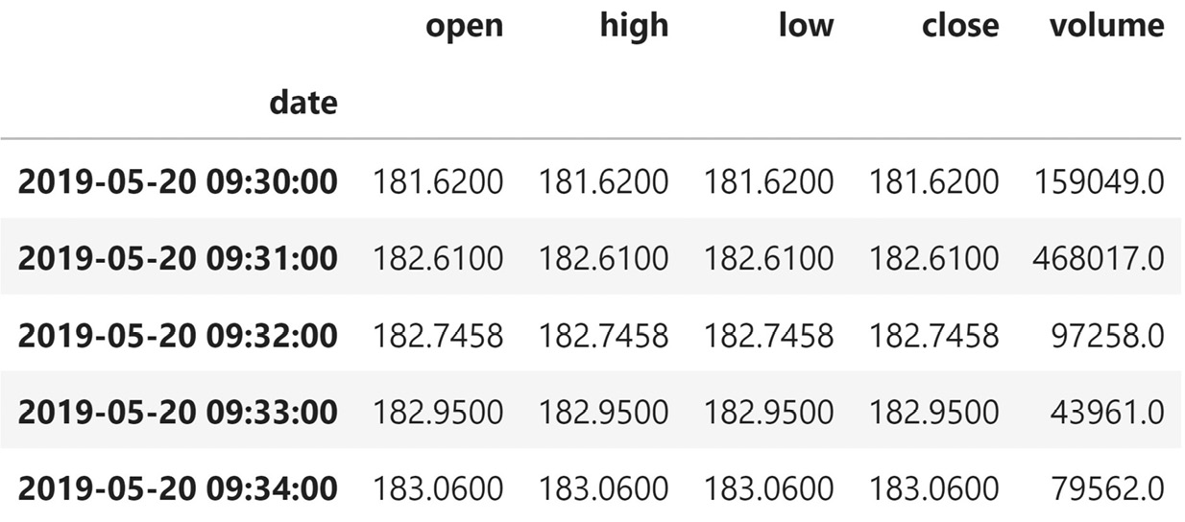
Time-based selection and filtering
We have the OHLC data per minute, along with the volume traded per minute:
Notes:
Important note
In order to properly parse datetimes in a non-standard format, we need to specify the format it is in. For a reference on the available codes, consult the Python documentation at https://docs.python.org/3/library/datetime.html#strftime-strptime-behavior.
We can use first() and last() with agg() to bring this data to a daily granularity. To get the true open value, we need to take the first observation per day; conversely, for the true closing value, we need to take the last observation per day.

Slide 88
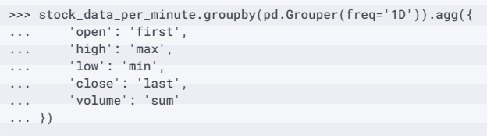
Time-based selection and filtering
The high and low will be the maximum and minimum of their respective columns per day.
Volume traded will be the daily sum:

Slide 89

Time-based selection and filtering
This rolls the data up to a daily frequency:

Slide 90
Time-based selection and filtering
The next two methods we will discuss help us select data based on the time part of the datetime.
The at_time() method allows us to isolate rows where the time part of the datetime is the time we specify.
By running at_time('9:30'), we can grab all the market open prices (the stock market opens at 9:30 AM):
>>> stock_data_per_minute.at_time('9:30')

Slide 91

Time-based selection and filtering
This tells us what the stock data looked like at the opening bell each day:
Notes:
We can use the between_time() method to grab all the rows where the time portion of the datetime is between two times (inclusive of the endpoints by default). This method can be very useful if we want to look at data within a certain time range, day over day.

Slide 92
Time-based selection and filtering
Let's grab all the rows within the last two minutes of trading each day (15:59 - 16:00):
>>> stock_data_per_minute.between_time('15:59', '16:00')

Slide 93

Time-based selection and filtering
It looks like the last minute (16:00) has significantly more volume traded each day compared to the previous minute (15:59).
Perhaps people rush to make trades before close:
Notes:
We may wonder if this also happens in the first two minutes. Do people put their trades in the night before, and they execute when the market opens? It is trivial to change the previous code to answer that question. Instead, let's see if, on average, more shares were traded within the first 30 minutes of trading or in the last 30 minutes for the week in question. We can combine between_time() with groupby() to answer this question. In addition, we need to use filter() to exclude groups from the aggregation.

Slide 94

Time-based selection and filtering
The excluded groups are times that aren't in the time range we want:

Slide 95
Time-based selection and filtering
For the week in question, there were 18,593 more trades on average around the opening time than the closing time:
>>> shares_traded_in_first_30_min \
... - shares_traded_in_last_30_min
18592.967741935485
Notes:
Tip
We can use the normalize() method on DatetimeIndex objects or after first accessing the dt attribute of a Series object to normalize all the datetimes to midnight. This is helpful when the time isn't adding value to our data. There are examples of this in the notebook.
With the stock data, we have a snapshot of the price for each minute or day (depending on the granularity), but we may be interested in seeing the change between time periods as a time series rather than aggregating the data. For this, we need to learn how to create lagged data.

Slide 96

Shifting for lagged data
From this new column, we can calculate the price change due to after-hours trading (after the market close one day right up to the market open the following day):
Notes:
We can use the shift() method to create lagged data. By default, the shift will be by one period, but this can be any integer (positive or negative). Let's use shift() to create a new column that indicates the previous day's closing price for the daily Facebook stock data.

Slide 97

Shifting for lagged data
This gives us the days that were most affected by after-hours trading:
Notes:
Tip
To add/subtract time from the datetimes in the index, consider using Timedelta objects instead. There is an example of this in the notebook.
In the previous example, we used the shifted data to calculate the change across columns. However, if, rather than the after-hours trading, we were interested in the change in Facebook's stock price each day, we would calculate the difference between the closing price and the shifted closing price. Pandas makes it a little easier than this, as we will see next.

Slide 98

Summary
In this lesson, we discussed how to join dataframes, how to determine the data we will lose for each type of join using set operations, and how to query dataframes as we would a database.
We then went over some more involved transformations on our columns, such as binning and ranking, and how to do so efficiently with the apply() method.
We also learned the importance of vectorized operations in writing efficient pandas code.
Notes:
Then, we explored window calculations and using pipes for cleaner code. Our discussion of window calculations served as a primer for aggregating across whole dataframes and by groups. We also went over how to generate pivot tables and crosstabs. Finally, we looked at some time series-specific functionality in pandas for everything from selection and aggregation to merging.
In the next lesson, we will cover visualization, which pandas implements by providing a wrapper around matplotlib. Data wrangling will play a key role in prepping our data for visualization, so be sure to complete the exercises that are provided in the following section before moving on.

Slide 99
"Complete Exercises"

Slide 100
"Complete Lab 4"

